Slide 1
Radio Systems
Pellissippi State
Applied Systems Development
Spring 2017

Slide 2
Introduction
Michelle

Slide 3
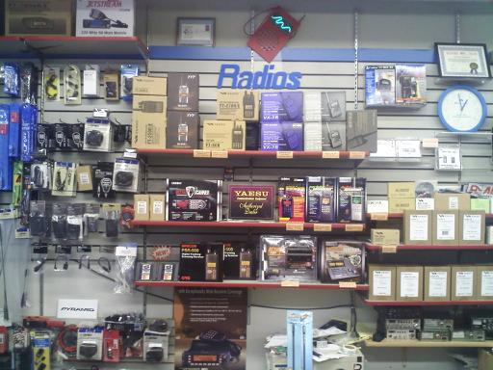
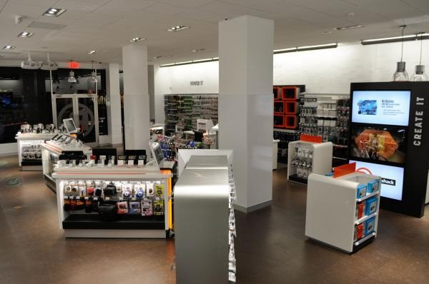
Radio Systems??

Slide 4
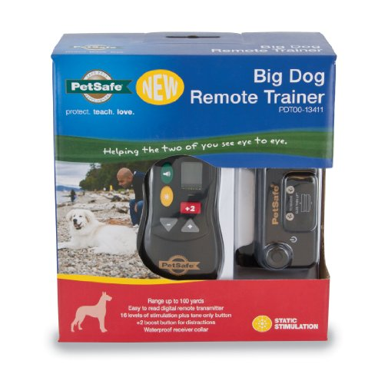


…Radio Systems

Slide 5
Company Facts: Locations:
Founded in 1991
Headquarters in Knoxville, TN
Initial IPO on Nasdaq in 1997
Now a Privately-Owned Multinational Corporation
Markets pet behavioral, containment, and lifestyle product solutions.
Last year, Radio Systems contributed more than $3,500,000 in volunteer support, grants, and product donations to organizations working to improve animal welfare or youth education.
Knoxville, Tennessee
Glen Allen, Virginia
Durham, North Carolina
Dundalk, Ireland
Chorley, United Kingdom
Shenzhen, China
Gold Coast, Australia

Slide 6
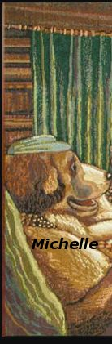
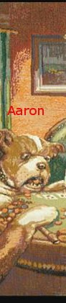
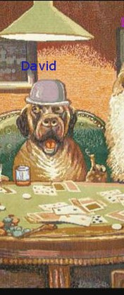
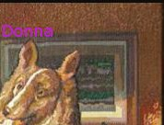
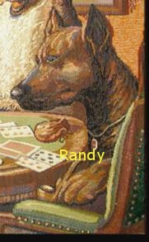

Team Radio Systems:

Slide 7
Technology
Lessons We’ve Learned….So Far!
Donna

Slide 8
In The Beginning….
Xaml
Node.JS
.Net
Electron
XML

Slide 9
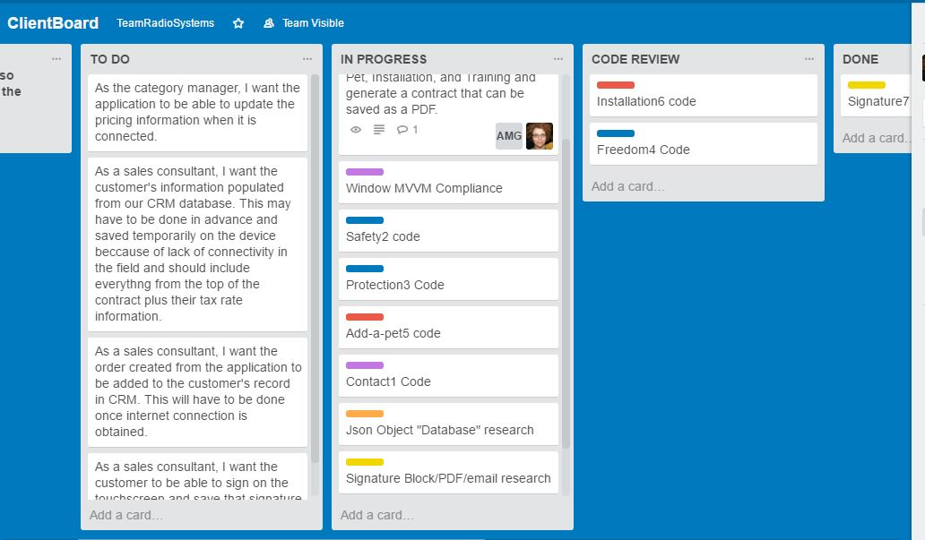
User Stories

Slide 10

C# .NET !!

Slide 11


.NET!!
Toolbox
Drag
Drop
Style
Double-Click
Event-Handler/Code
Done!

Slide 12
A “New” .Net, but only to us…
??
WPF
XAML

Slide 13
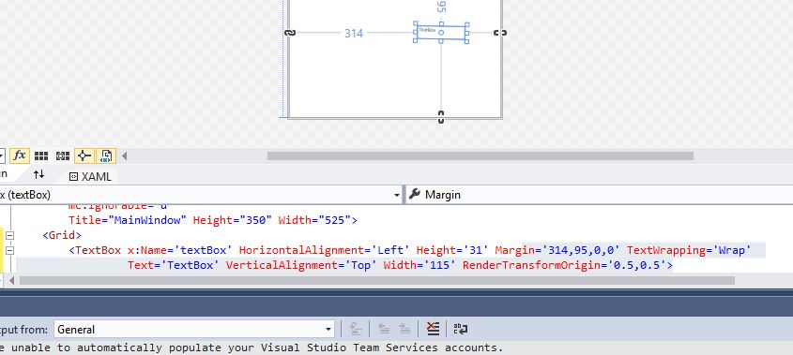
Drag & drop & move in Xaml

Slide 14
WPF
Advantages
Disadvantages
Feels more like real coding.
Provides the programmer more control over the precise outcome of the GUI.
Incorporates Setters much like CSS3 classes to allow styling of groups of controls to make them look uniform.
Has strong binding capability that allows easy access to resources.
Controls are hand-coded.
Setters are hand-coded.
Everything is hand-coded, except if you have an existing Json file, it will write your object for you from the file!!
The language is considered “fully-matured.”

Slide 15

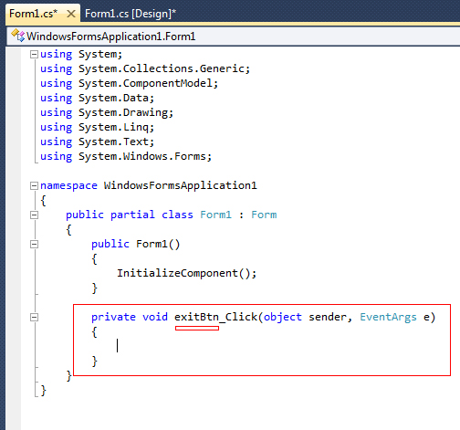

Architecture: Code Behind
GUI
Separation of Concerns

Slide 16

Architecture: MVVM
Dependencies
Commands
Bindings
Triggers
Data Templates
Data Context
INotifyPropertyChanged

Slide 17
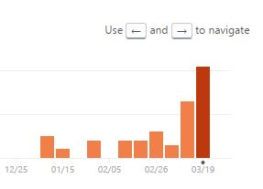
GitHub Project Activity

Slide 18

Wiki Walkthrough
Aaron

Slide 19
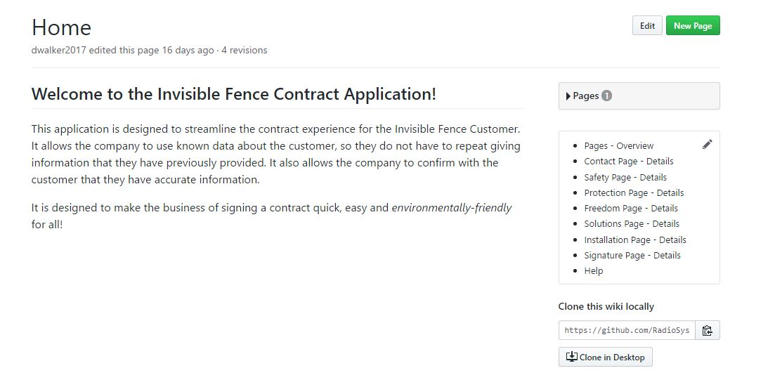
GitHub Wiki Home

Slide 20
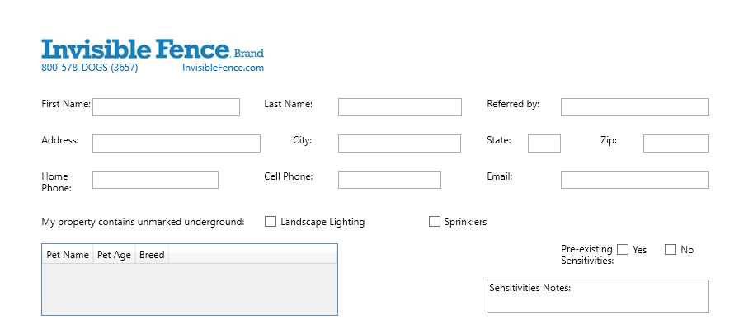
Contact

Slide 21
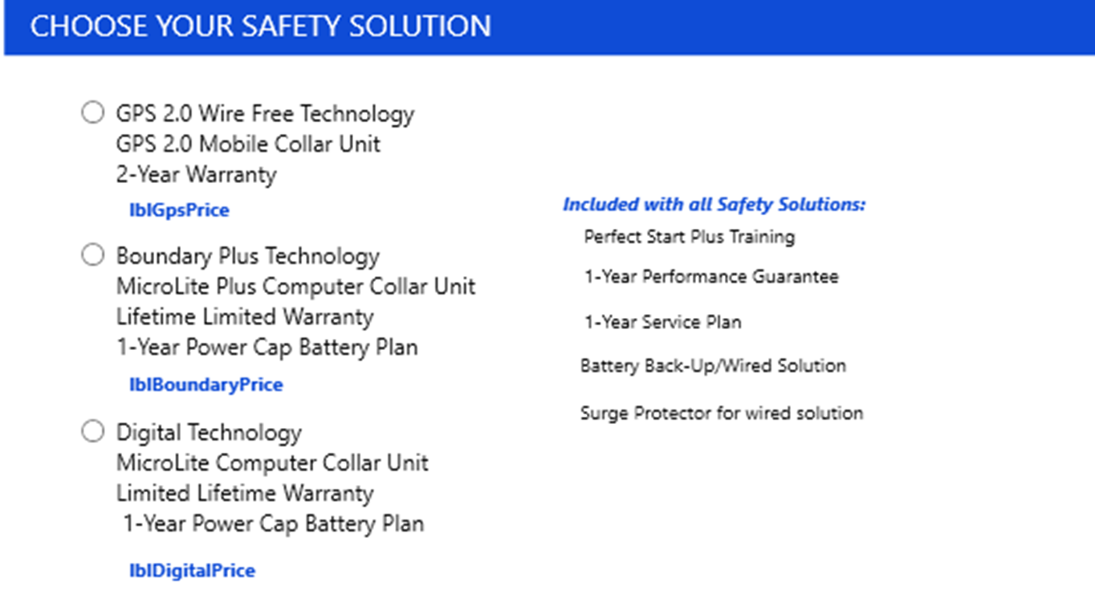
Safety

Slide 22
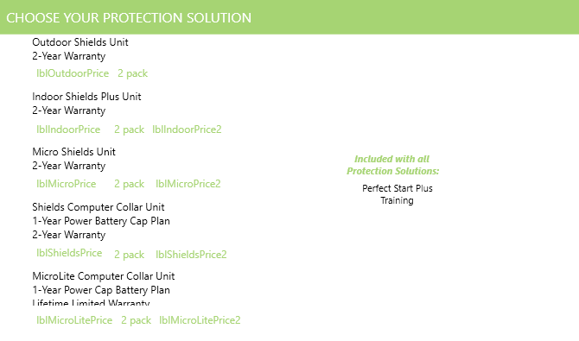
Protection

Slide 23
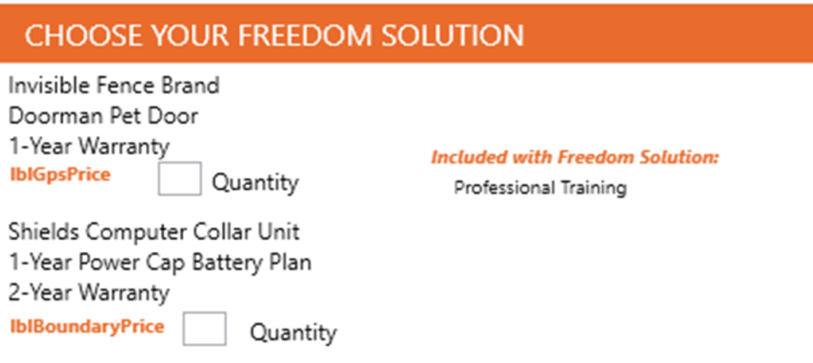
Freedom

Slide 24
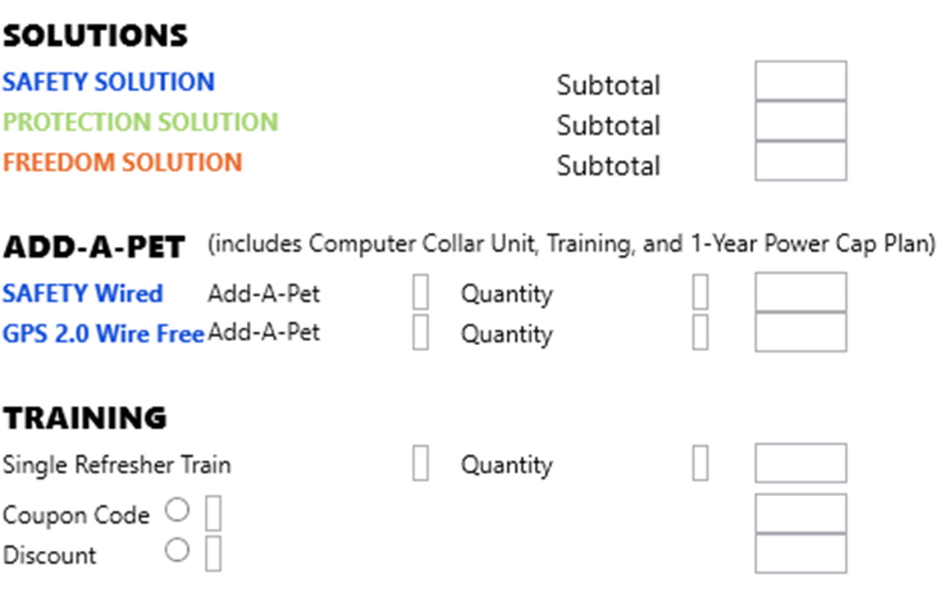
Solutions

Slide 25
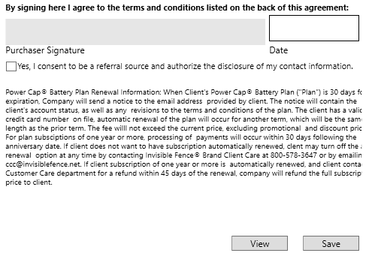
Signature

Slide 26
Signatures, PDFs & Emails
Randy

Slide 27

InkCanvas
WPF control/class that is used to capture ink strokes.
Input is stored as Stroke objects.
These objects will be stored with the rest of the client information.
Stroke objects will then be inserted into the PDF along with the rest of the client information.

Slide 28
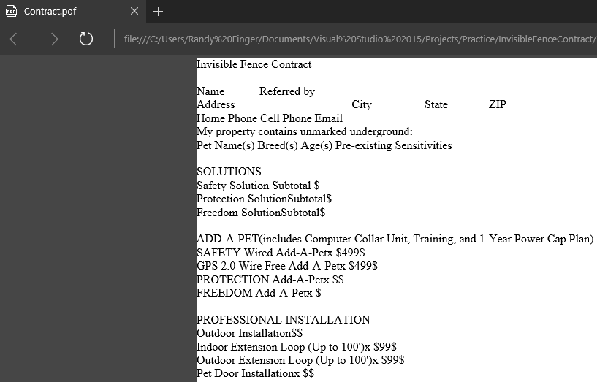
PDFsharp
PDFsharp is a .NET library that is used to create pdf files and allows you to control every line of text that is drawn.
PDFsharp version 1.32 is being used to create contract PDF.
PDFsharp has the ability to create pdf documents from text or image data.
Two possible approaches for application:
1. Create pdf using text data. Format the text to resemble contract.
2. Create view and populate with data. Create pdf from view image.
Current approach: Text data
PDFsharp allows different fonts, font sizes, font color, etc.

Slide 29
SendGrid
SendGrid is a cloud-based SMTP(Simple Mail Transfer Protocol) provider.
Client preference for sending email
Two ways to send email:
1. SMTP relay
2. Web API
Current approach: Web API
Client wants contract to be emailed to Radio Systems customer care center and to the client.

Slide 30



Data in Pieces
By David

Slide 31


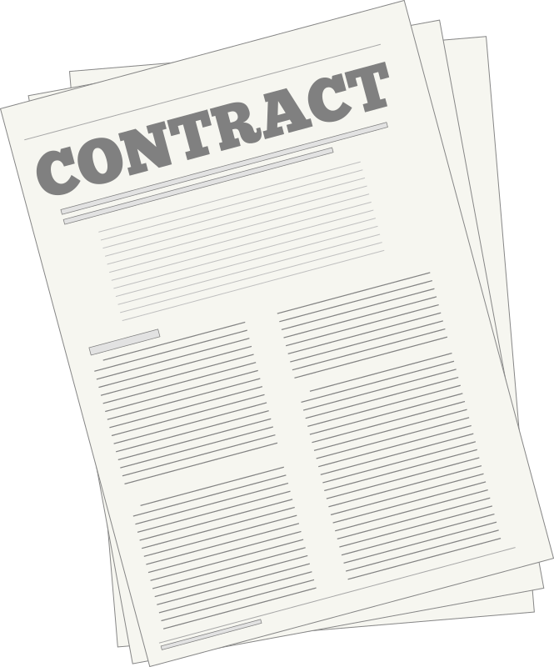

Data Flow

Slide 32

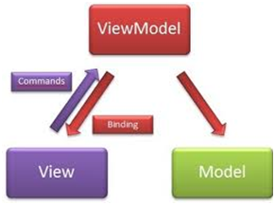
Architecture

Slide 33
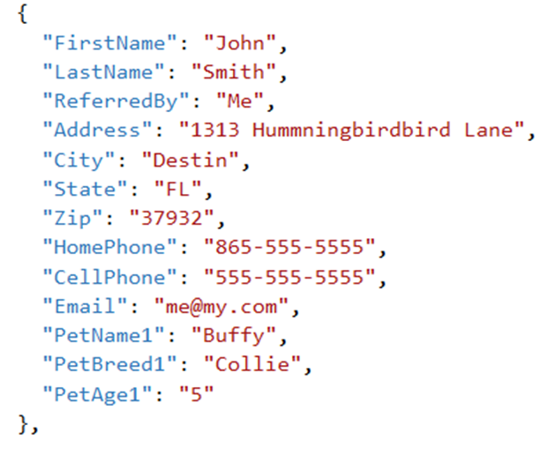
Incoming File

Slide 34
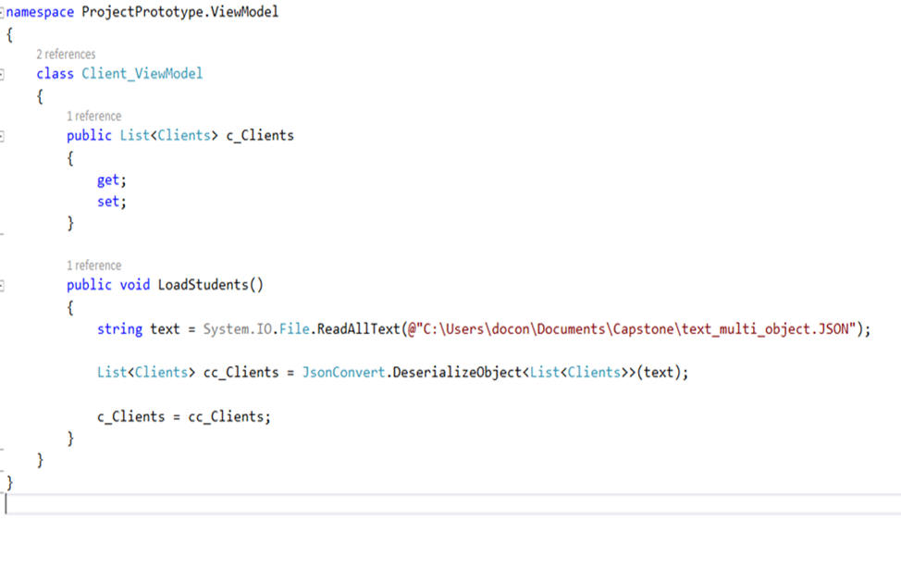
Code

Slide 35
Output
{
"FirstName": "John",
"LastName": "Smith",
"ReferredBy": "Me",
"Address": "1313 Hummningbirdbird Lane",
"City": "Destin",
"State": "FL",
"Zip": "37932",
"HomePhone": "865-555-5555",
"CellPhone": "555-555-5555",
"Email": "me@my.com",
"PetName1": "Lassie",
"PetBreed1": "Collie",
"PetAge1": "5"
},

Slide 36

Construction Completion Date: 4/22/17

Slide 37


No pets were harmed in the making of this presentation…

